Slide 1
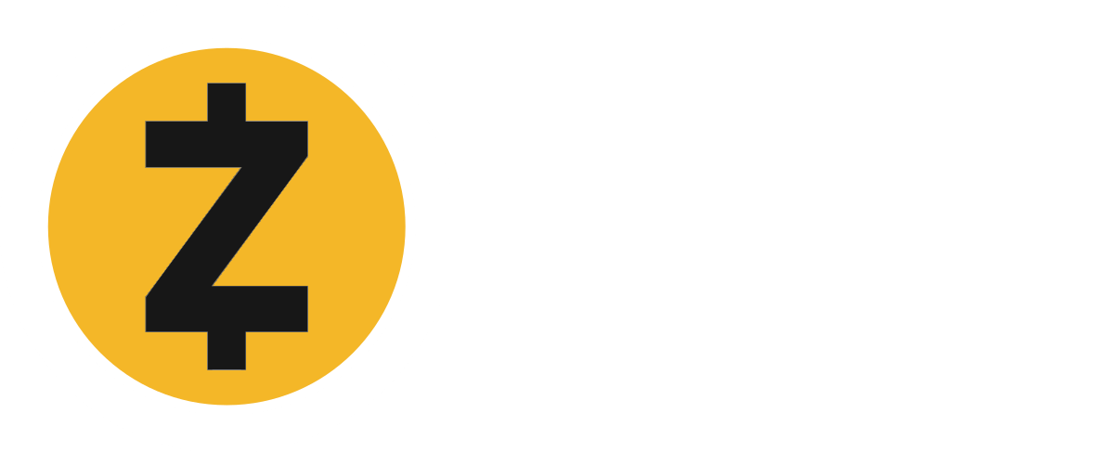



COMPARING PRIVACY COINS
COIN SUPPLY & EMISSIONS
CURRENT SUPPLY
9.7M
17.6M
10.6M
FINAL SUPPLY
21M
21M
PRIVACY
% TRANSACTIONS PRIVATE (July 2020)
1%
100%
100%
ADDRESSES STORED IN CHAIN?
YES
YES
NO
DANDELION?
NO
YES
YES
DESIGN
zk-SNARKs
RingCT
Mimblewimble
SETUP CONFIG
TRUSTLESS
TRUSTED
TRUSTLESS
When privacy is optional, choosing to enable private transactions arouses suspicion. When addresses are stored in the blockchain, advances in computing power could lead to future de-anonymization.
SCALABILITY
BLOCKCHAIN SIZE
27GB
64GB
1.3GB
MINING
CPU
GPU
ASIC
GOVERNANCE & FUNDING
GOVERNANCE
Corporate
Community
Community
FUNDING
20% dev fee
Donations
6.66% dev fee
(Declining 1.1% annually)
Version v06 – 17th Mar 2021

